Slide 1
100 Books Project!
What is it?
How can we succeed?

Slide 2
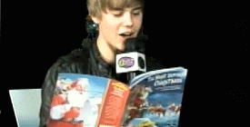
Justin Beiber reads…

Slide 3
… So does Beyonce

Slide 4
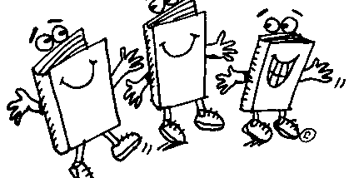
What are you reading?

Slide 5
What the 100 Books Project is:
A goal for all Bowman students to read 100 books by the time they graduate St. Aloysius
An expectation that all Bowman girls will be reading a pleasure reading
An opportunity to share books with other students
A creative way of responding to literature that you choose

Slide 6
What the 100 Books Project is NOT:
A goal that will be achieved in a day
A time for teachers to tell you what books you like
A project meant to be done with books from Read-a-Story class
Something to stress out about and give up on!

Slide 7
Why are we doing the 100 Books Project?

Slide 8
What you will need to succeed:
A positive attitude!!
An awareness of what kind of books you enjoy reading, which authors you like, and where you like to read
An open mind
Commitment

Slide 9
What happens after you read the book?
6th grade will complete ONE book project/ quarter
7th and 8th grade will complete TWO book projects/quarter
Weekly summaries and reading logs
Weekly commercials

Slide 10
When do we read these books?
SSR
At home
At the park
On the bus
On the subway

Slide 11
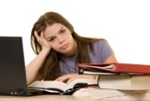
SSR shouldn’t look like this…

Slide 12
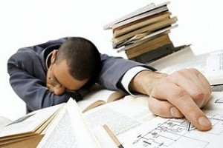
Or this…

Slide 13
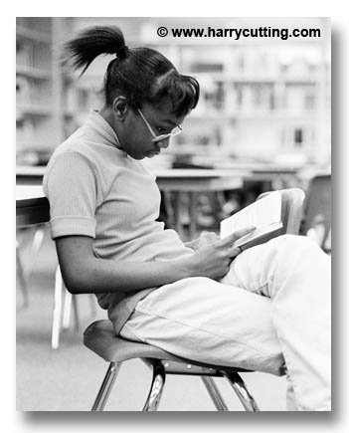
SSR should look like this…

Slide 14
Or this…

Slide 15
Expectations
You will do your best
You will ask when you need help choosing books or completing projects
You will be honest
You will have a positive attitude!

